Slide 1

Intel Do-It-Yourself Challenge Networking
Nicolas Vailliet www.Intel-Software-Academic-Program.com paul.guermonprez@intel.com Intel Software 2014-02-01

Slide 2
Galileo as a linux server
Boot from SD card
There’s an embedded linux on the board, but you can also boot from a microSD card.
Customize the Yocto build
There’s reference Yocto builds on Intel’s website, but you can also build your own Yocto (sources and drivers are available, including for Wi-Fi).
Network
There’s an Ethernet port on the board (on a non-Intel Arduino board, an Ethernet shield would cost 29euro+VAT),
and MiniPCI-e WiFi cards (laptop-style) can be plugged.

Slide 3
We’ll use …
OS
Ubuntu 12.04 LTS (other Oses are supported)
Galileo IDE and drivers
Intel Galileo Arduino SW (IDE and drivers) https://communities.intel.com/docs/DOC-22226 Download the “Linux image for SD”
Micro SD card
The micro SD card is not provided in the box. To plug the SD card on a PC, you’ll need an adaptor.

Slide 4
Preparing and booting the SD card

Slide 5


SD card
Format the micro SD Card
Connect the micro SD card to your PC, format as fat32.
Adapters
To connect the microSD to your PC, you can use :
> A SD-microSD adapter if you have a SD slot in your PC
> A USB-microSD adapter

Slide 6
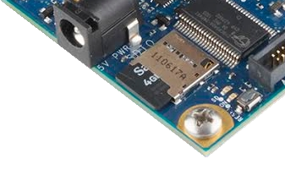
Boot
Boot loader
The Galileo board is using grub, a common tool, which load an ext3 file system.
How to boot
Plug the SD card in the slot of the Galileo board.
Plug the power supply, wait for the green LED, plug via USB.
What’s working ?
You can still send sketches from the Arduino IDE, but you now have a linux running with included services and libraries like SSHd, bluez, nodejs, OpenCV.

Slide 7
Enable networking

Slide 8
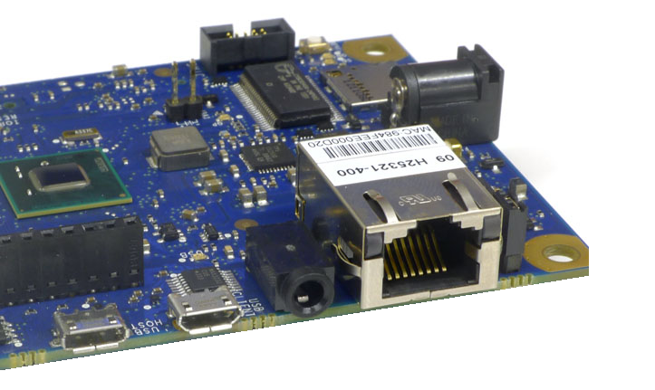
Ethernet
Auto configured
Once booted, Linux OS will start SSH for the first time. Wait a minute before trying to it. We’ll need to run a sketch from the Arduino IDE to :
> use the “Ethernet” package to enable the Ethernet port > launch a ifup linux command with “system” to enable the interface.
Then your board will receive an IP address from your local DHCP server (usually your home router), or will use the fixed IP you provided if DHCP doesn’t work.
Then you’ll be able to connect with ssh and get rid of the IDE.

Slide 9
Ethernet
Procedure
> Plug the Ethernet cable
> Copy/Paste the sketch on next slide to your IDE window
> Edit the MAC (sticker on your board) and IP values
> Validate and upload.
> Determine your IP address.
> ssh to your Galileo IP as root.

Slide 10
Sketch to copy/paste
#include <SPI.h>
#include <Ethernet.h>
// MAC address for the Galileo (there’s a sticker on the Ethernet connector)
byte mac[] = { 0x??, 0x??, 0x??, 0x??, 0x??, 0x?? };
//the IP address for the Galileo: (will be used if there’s no DHCP server on your network)
byte ip[] = { ???, ???, ???, ??? };
void setup() {
delay(5000);
Serial.println("Attempting to configure Ethernet using DHCP");
if (Ethernet.begin(mac) == 0) {
Serial.begin(9600);
Serial.println("Failed to configure Ethernet using DHCP");
Serial.println("Attempting to configure Ethernet using Static IP");
Ethernet.begin(mac, ip);
Serial.println(" Please check ifconfig");
} else
Serial.println("Sounds good");
system("ifup eth0"); // load Ethernet interface!
}
void loop () {}

Slide 11
What’s my IP ?

Slide 12
What’s my IP address ?
Fixed IP
If you have no DHCP router and entered an IP, you have it.
Router info page
If you have a home router, you can consult the DHCP log.
Display ifconfig output
Run sketch from the following slide, it will : > run the ifconfig linux command > output the result in a file > display the file content

Slide 13
Sketch to copy/paste
char output[500];
void setup(){
Serial.begin(9600);
}
void loop(){
system(“ifconfig > log.txt”);
FILE *fp;
fp = fopen(“log.txt”,”r”);
while(fgets(output,500,fp) != NULL)
Serial.println(output);
fclose(fp);
delay(5000);
}

Slide 14
ssh

Slide 15
ssh
Serial log
After running the sketch, your board should be connected to your LAN network.
ssh
To access the board with ssh, the user is root, with no password.
ssh root@192.168.1.100 //replace with your IP You should see : root@clanton:~#
Reboot ?
If you reboot your card, you should be able to reconnect automatically. Wait at least 45 seconds for the OS
to load the network and ssh service.

Slide 16
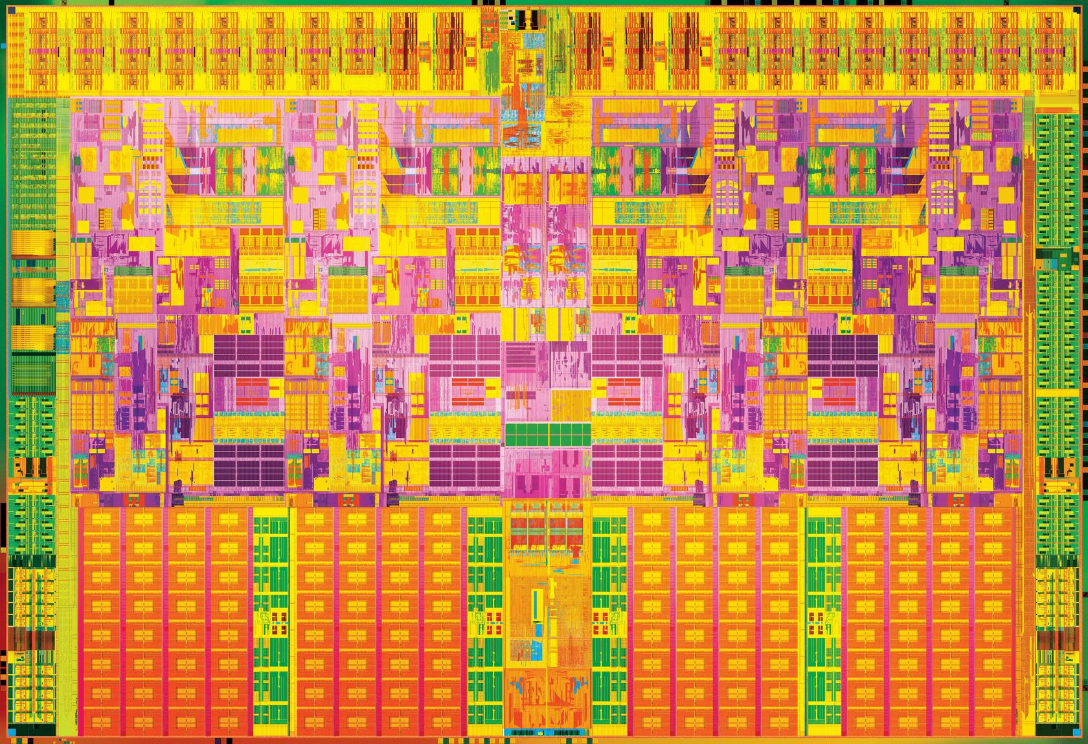

Slide 17
License Creative Commons – By 3.0
You are free:
to Share — to copy, distribute and transmit the work
to Remix — to adapt the work
to make commercial use of the work
Under the following conditions:
Attribution — You must attribute the work in the manner specified by the author or licensor (but not in any way that suggests that they endorse you or your use of the work).
With the understanding that:
Waiver — Any of the above conditions can be waived if you get permission from the copyright holder.
Public Domain — Where the work or any of its elements is in the public domain under applicable law, that status is in no way affected by the license.
Other Rights — In no way are any of the following rights affected by the license:
Your fair dealing or fair use rights, or other applicable copyright exceptions and limitations;
The author's moral rights;
Rights other persons may have either in the work itself or in how the work is used, such as publicity or privacy rights.
Notice — For any reuse or distribution, you must make clear to others the license terms of this work. The best way to do this is with a link to this web page.
http://creativecommons.org/licenses/by/3.0/

